Slide 1
RFID BASED SMART ATTENDANCE SYSTEM

Slide 2
AGENDA
INTERNET OF THINGS
INTRODUCTION
EXISTING SYSTEM and PROPOSED SYSTEM
PROPOSED SYSTEM ARCHITECTURE
MODULES
APPLICATIONS
FUTURE SCOPE
CONCLUSIONS

Slide 3
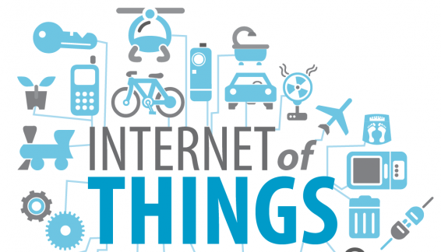
Internet of Things
The term "Internet of Things" has come to describe a number of technologies and research disciplines that enable the Internet to reach out into the real world of physical objects

Slide 4
INTRODUCTION
Network of physical objects
Inter-relates computing devices
Better relationship between human and nature
IoT links smart objects to the Internet.
Exchange of data in more secure way.

Slide 5
PROBLEM STATEMENT
The risk of losing the attendance data is very high.
since most of the attendance systems that are being used in universities still are written a piece of paper
For laboratory session the student still have to sign on the attendance sheet.
It is also creating lots of paper work and also have chances of manipulating the attendance records

Slide 6
EXISTING AND PROPOSED SYSTEM
DISADVANTAGES
Not reliable
Lots of paper work
Risk of losing attendance data
EXISTING SYSTEM
“manual attendance”
PROPOSED SYSTEM
“RFID based attendance”
ADVANTAGES
Wireless Communication
More reliable
Increased availability
Real time data gathering

Slide 7
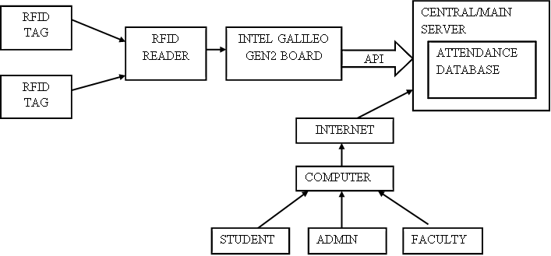
PROPOSED SYSTEM ARCHITECTURE

Slide 8
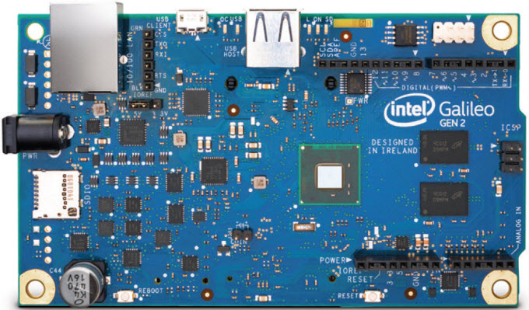
Intel Galileo gen2
The 2nd generation Intel Galileo board provides a single board controller for the maker community, students and professional developers. Based on the Intel Quark SoC, a 32-bit Intel Pentium processor-class system on a chip(SoC).

Slide 9
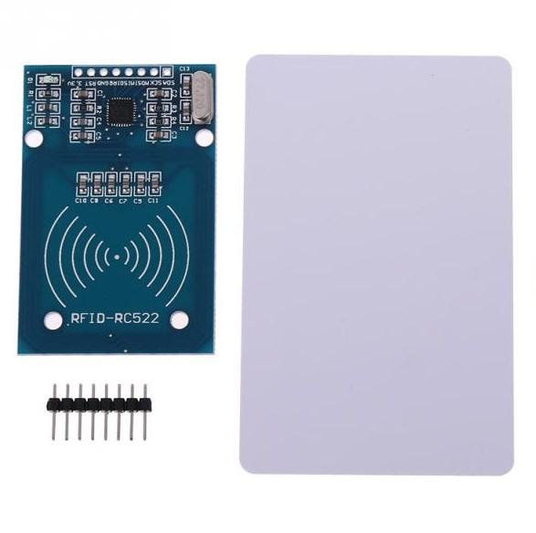
RFID reader with card
A radio frequency identification reader (RFID reader) is a device used to gather information from an RFID card, which is used to track individual objects.
Radio waves are used to transfer data from the card to a reader
RFID technology uses digital data in an RFID tag, which is made up of integrated circuits containing a tiny antenna for transferring information to an RFID transceiver

Slide 10
Modules
Student Registration with the System
Data collection from RFID
Store Data in the private cloud
GUI for users

Slide 11
Student Registration with the System
Admin registers new student by collecting his credentials and by providing a RFID card which has got a unique ID
1 If (rfid.IsCard())=true
2 If (rfid.readCardSerial())=true
3 data=rfid.serNum
4 EndIf
5 Else No Card Found
6 EndIf
7 Lcd.print(data)
8 url
9 Login as Admin
10 Register student credentials along with data obtained
11 Store it in student database

Slide 12
Data collection from RFID
Proposed system can record the attendance status of the student in this module
1 If (rfid.IsCard())=true
2 If (rfid.readCardSerial())=true
3 data=rfid.SerailNum()
4 If data=Registered student Id
5 Store in the attendance database
6 EndIf
7 EndIf
8 Else No card found
9 EndIf

Slide 13

Store Data in the private cloud
The cloud provides computing for end users in a remote environment, where the actual software runs as a service rather than on each end-user's computer.
OpenStack deploy virtual machines and other instances that handle different tasks for managing a cloud environment puting platforms for public and private clouds.
.

Slide 14
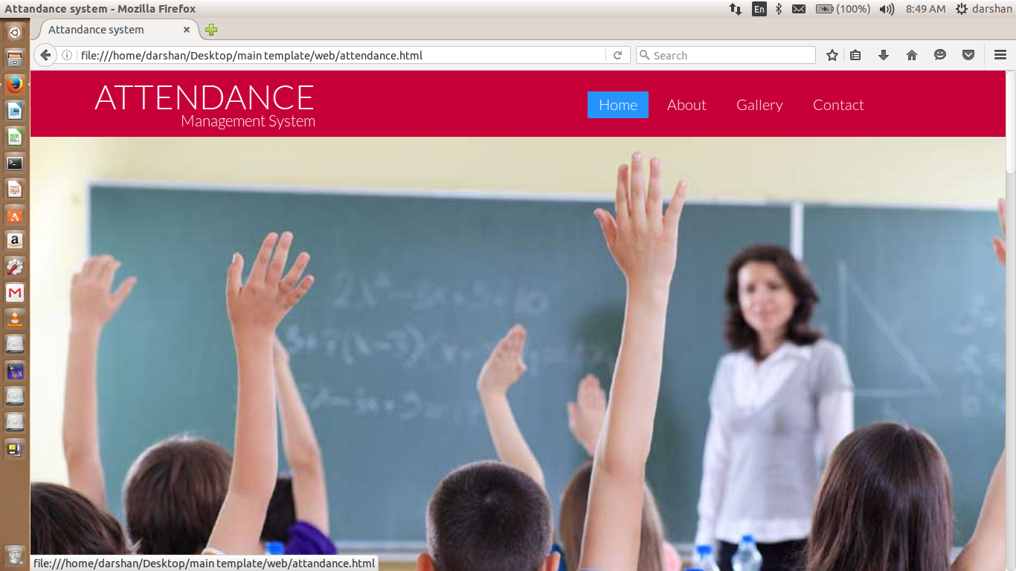
Attendance system home page
GUI for users

Slide 15
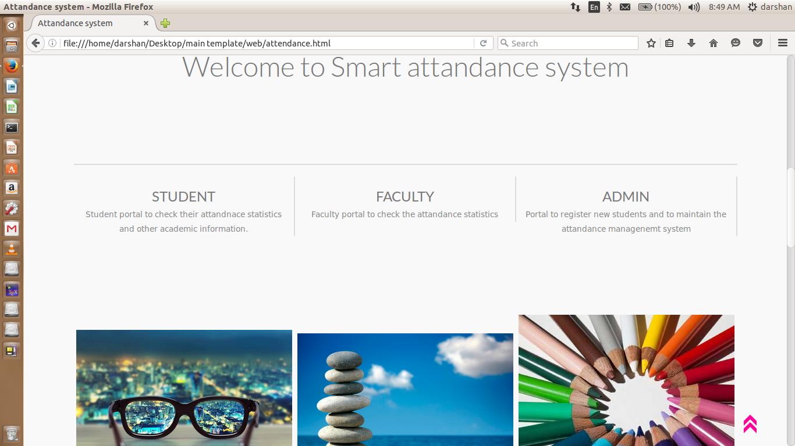
Attendance system home page(cont)

Slide 16
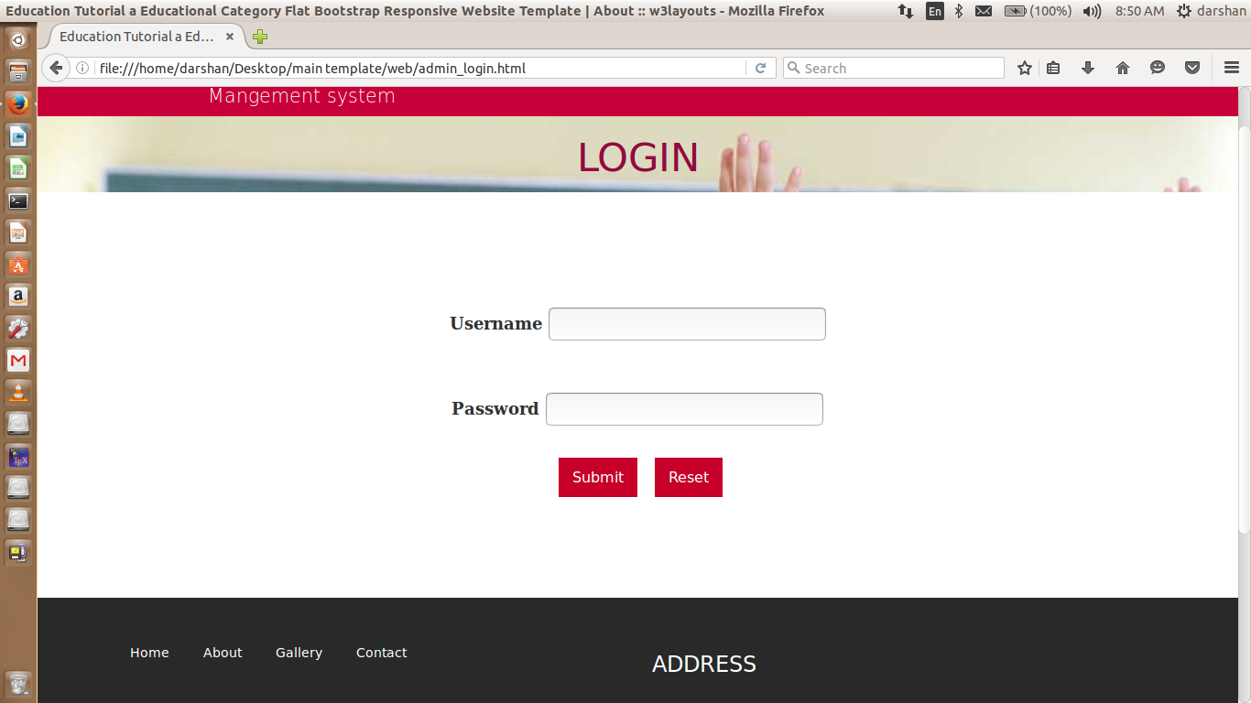
Login

Slide 17
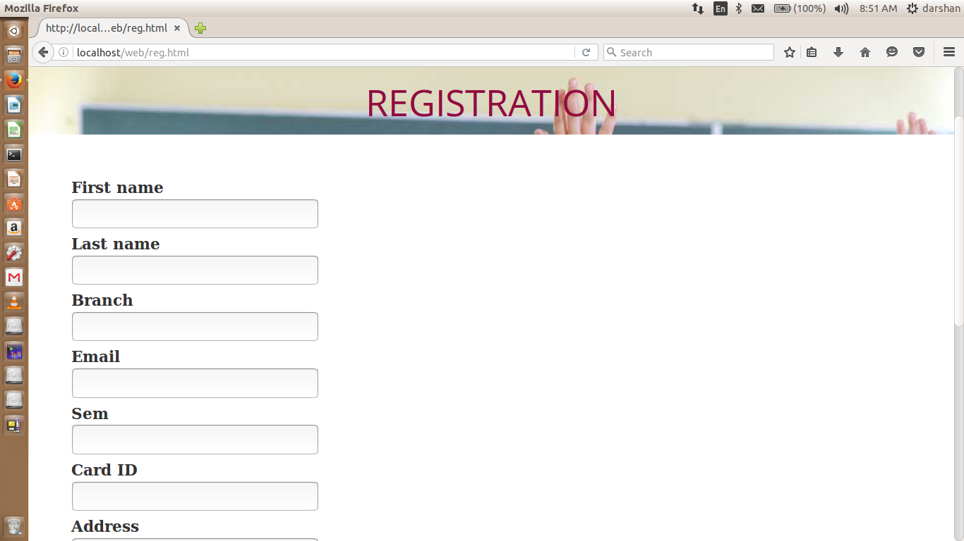
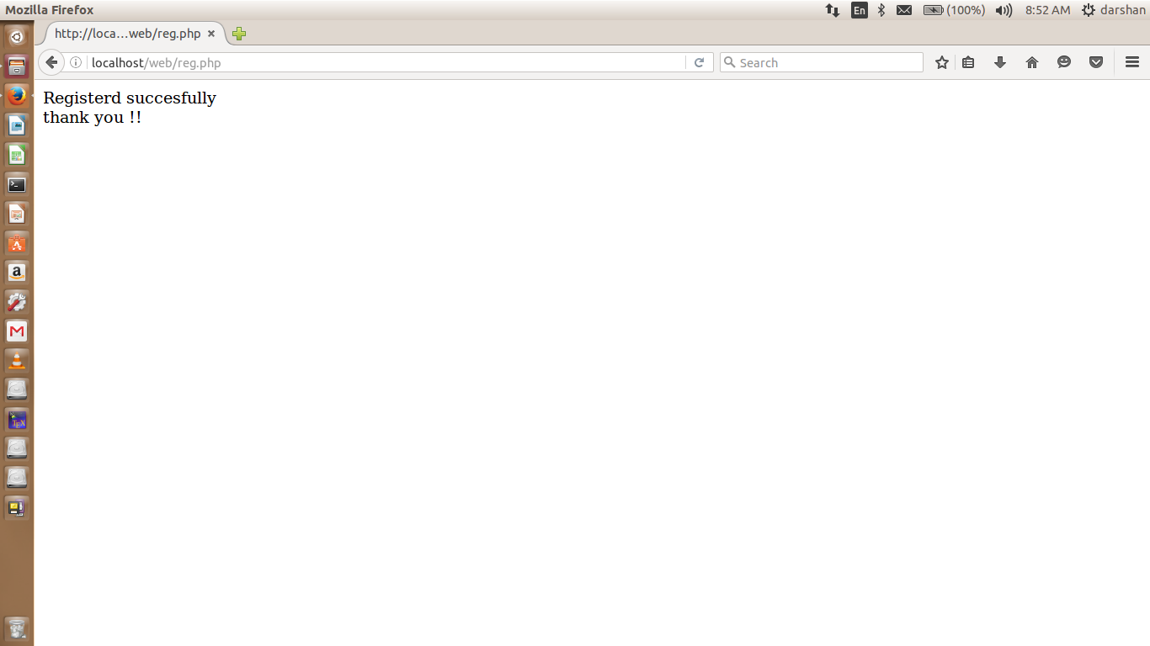
Registration form

Slide 18
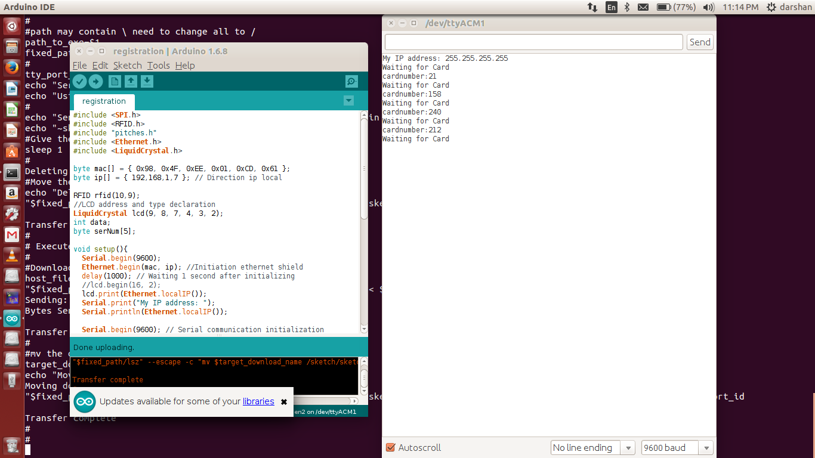
Getting card numbers in Arduino IDE

Slide 19
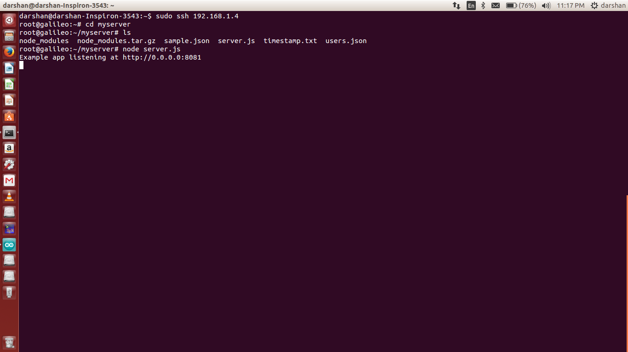
Running server at Intel Galileo Gen 2

Slide 20
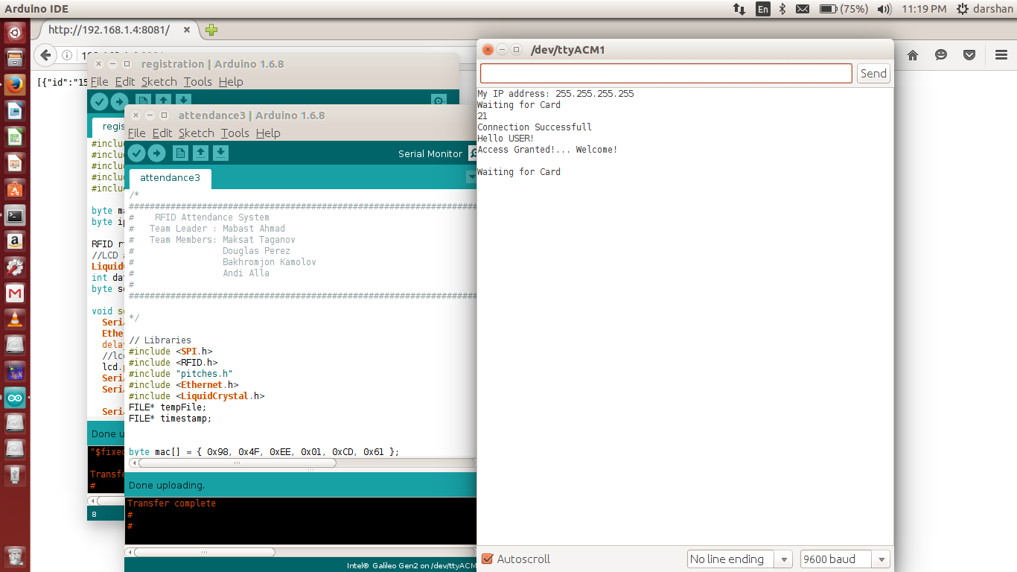
Checking for Validation of card

Slide 21
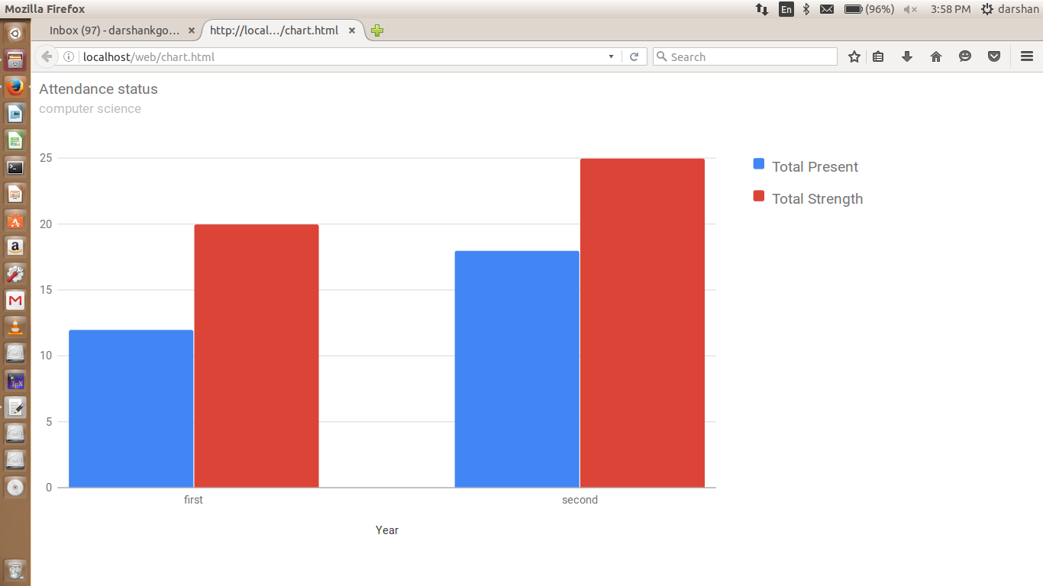
Bar Chart

Slide 22
Applications
This project can be used by schools and colleges to monitor the students
The cloud based web application can be used to access the attendance status of student from anywhere with in campus
This can also be used in Labs and libraries

Slide 23
Future work
Interfacing the system with a GSM so data can be transmitted through messages instantly
Hex Keypad can be interfaced to microcontroller board by which user can enter his password.
Providing camera along with this system provides more security by Authenticating students

Slide 24
Conclusion
Here by we can conclude that this RFID based smart attendance system helps college to maintain the attendance system in a better way
It reduces lots of paper work, time and money

Slide 25
Thank you

